Slide 1
WVSP Forensic Laboratory Evidence Processing Section
David W. Miller
304-746-2412
david.w.miller@wvsp.gov

Slide 2
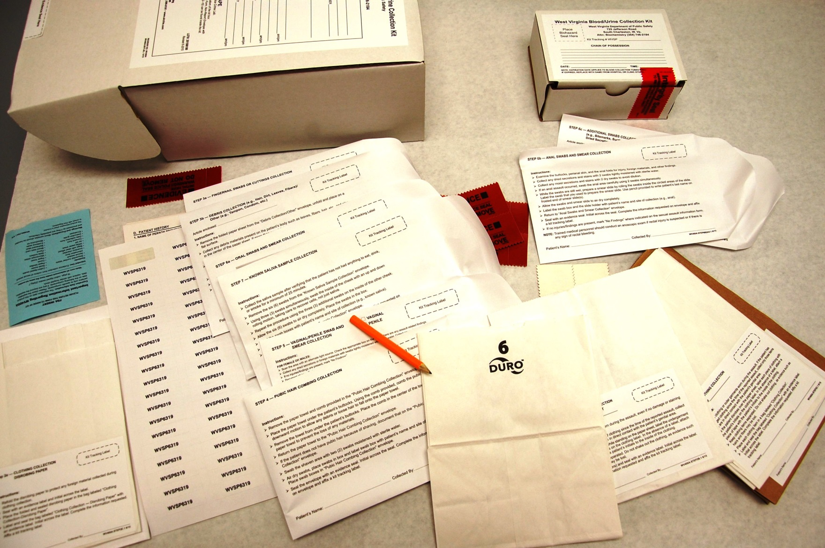
West Virginia Sexual Assault Evidence Collection Kits (SAECKs)

Slide 3
West Virginia Sexual Assault Evidence Collection Kits (SAECKs)
LESS THAN HALF OF ALL COLLECTED SAECKS ARE SUBMITTED TO THE WVSP FORENSIC LABORATORY
So far in 2018:
591 Kits have been distributed to hospitals in WV
213 Kits have been submitted to the lab
229 Kits have been examined at the lab

Slide 4
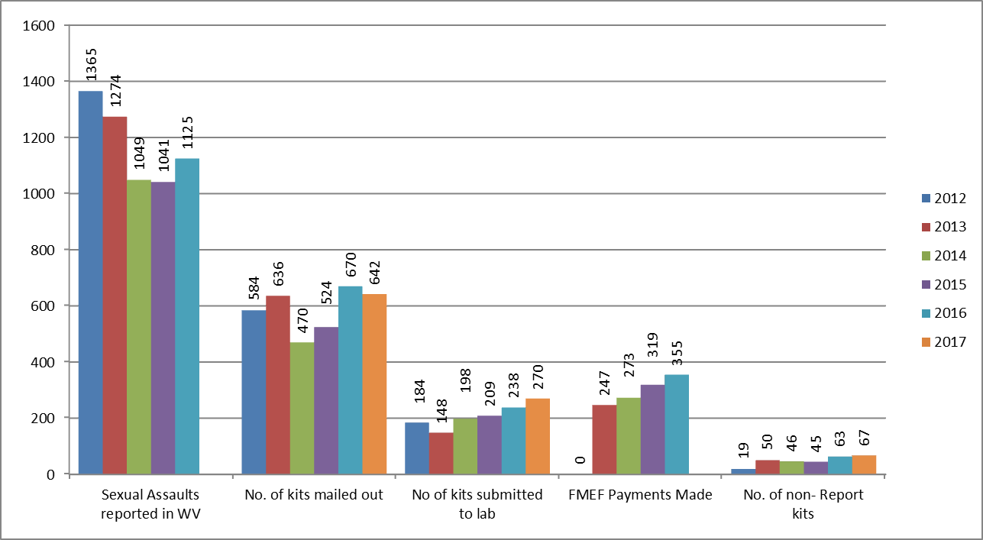
West Virginia Sexual Assault Evidence Collection Kits (SAECKs)

Slide 5
West Virginia Sexual Assault Evidence Collection Kits (SAECKs)
DANY/SAKI Grants
Previously unsubmitted kits going back decades are being inventoried and tested.
DNA results are being generated and compared to:
DNA results from other cases, nationally
DNA profiles from convicted offenders

Slide 6
West Virginia Sexual Assault Evidence Collection Kits (SAECKs)
In West Virginia:
1,748 cases have been submitted to MUFSC for testing
538 cases sent to BODE for testing
1,223 Lab reports were submitted to WVSPFL from MUFSC
1,003 Cases reviewed or in progress for possible upload into CODIS (including 2,369 samples reviewed thus far)
49 Counties in CODIS review process
258 Total CODIS entries
76 CODIS hits

Slide 7
West Virginia Sexual Assault Evidence Collection Kits (SAECKs)
SAFE: Sexual Assault Forensic Examination Commettee: Subcommittee of the Governor’s Committee on Crime, Delinquency, and Violence
Has rule-making authority
Will likely propose a rule stating that ALL collected sexual assault kits must be submitted to the WVSP forensic laboratory.

Slide 8
West Virginia Sexual Assault Evidence Collection Kits (SAECKs)
It has been discussed that one way to accomplish the submission of all kits, is to have the kit mailed to the laboratory, directly from the hospital, once it is collected.
To see if this is feasible, and to identify any obstacles, it has be proposed to pilot the idea at WVU-Ruby Hospital.

Slide 9
West Virginia Sexual Assault Evidence Collection Kits (SAECKs)
Some questions have already been raised.
Other questions are sure to be asked.

Slide 10
WVSP Forensic Laboratory Evidence Processing Section
David W. Miller
304-746-2412
david.w.miller@wvsp.gov

